Slide 1
Projected Food Price Inflation in Fragile Country
TAYLOR M SMITH, TODD LINDEN & ABDU MUNYE
COMP 4447 - DATA SCIENCE TOOLS 1

Slide 2
Data & Motivation
The data set that we chose was from the The World Bank, which contains monthly food price estimates by product and market. We focused on Afghanistan, which is a public data set that covers 64 markets from 2007 to 2023.
We wanted to look at this data set because we were interested in predicting the food price estimates in a fragile country after major world events had occurred.
–

Slide 3
Research Questions:
Research Question: How have global economic events, such as the 2008 financial crisis, the COVID-19 pandemic, and Taliban Takeover affected food price inflation?
This question can be broken up into three questions for the purpose of analysis:
How did the 2008 financial crisis affected food price inflation?
How did the COVID-19 pandemic affected food price inflation?
How did the Taliban Takeover affected food price inflation?

Slide 4
Data Source:
We downloaded the data from The World Bank webpage and placed it into a csv file in preparation for Data munging and Data Wrangling.
Afghanistan - Monthly food price estimates by product and market (worldbank.org)
https://datacatalog.worldbank.org/search/dataset/0060198/Syrian-Arab-Republic---Monthly-food-price-estimates-by-product-and-market
The data was collected from 01/01/2007 to 01/04/2023 covering 64 markets in the Afghanistan.

Slide 5
Data munging / Data Wrangling & Statistical Summary
When we looked at the initial data set, we were able to determine that this data set was a time-series
This provides insight into how we want to manipulate the data
This also helps us determine what type of tool to use to model the data analysis
We formatted and manipulated the data into three columns Indicator, Date, and Value (Percentage).
The Indicator column was made up of Food Inflation and Inflation Rate labels
The Date column was made up of monthly dates up starting from 3/31/2005 through 2/28/2023
The Value column was the percentage of food inflation and the percentage of inflation rate

Slide 6
Introduction to Data Analysis:
For the data analysis we used SARIMAX in the statsmodels class.
There are several techniques that can be used for handling time-series data, but for this case SARIMAX turned out to be the most applicable
Some other techniques are AR, MA, ARIMA, and SARIMA.
AR – Autoregressive: This is a model that relies on past period values to predict current ones
MA – Moving Average: This is a model considers past residuals
This is to help account for unpredictable events that effect the data analysis
ARIMA – Autoregressive Integrated Moving Average: This model uses past data as a foundation for estimates while incorporating past residuals to deal with unpredictable events
SARIMAX:
This is a Seasonal Auto-Regressive Integrated Moving Average with eXogenous factors
Is used to forecast time series
This technique is built upon AR, MA, ARIMA, etc. it allows for the evaluation of data that is common to actual events
This tool is a good fit for our data because we are dealing with time-series data, which also contains unpredictable data points, and the data was also seasonal
Resource:
https://www.statsmodels.org/dev/generated/statsmodels.tsa.statespace.sarimax.SARIMAX.html

Slide 7
Data Analysis:
Load the data: The initial step in any data analysis is loading the data. Here, the pandas read_csv function is used to read the data from a CSV file into a DataFrame.
Set the index: The 'Date' column is converted to datetime format and then set as the index of the DataFrame. The reason for this is that we're dealing with time-series data, so the dates need to be the index for the DataFrame.
df['Date'] = pd.to_datetime(df['Date'])

Slide 8
Data Analysis:
Calculate average food price inflation rate for financial crisis (2008-2009), COVID-19 pandemic (2020-2021), and Taliban takeover (2021-2022)
Reference Code Cell 4 in Markdown for generating average food price
Reference Code Cell 5 for printing out results
Inflation projections Assuming you want to forecast global inflation rates (average across all countries)
Test for stationarity using Augmented Dickey-Fuller Test
If p-value > 0.05, the time series is not stationery and differencing is required

Slide 9
Data Analysis:
Split the data: The data is split into two separate DataFrames, one for each 'Indicator'. This is done because we want to analyze and forecast these two series separately.
Resampling: The data is then resampled at the end of each month, which means that if there were multiple data points within a single month, they would be consolidated into one data point (the last one of the month). In this case, since the data already seems to be in a monthly format, this step might not have any effect, but it's good practice when dealing with time-series data.

Slide 10
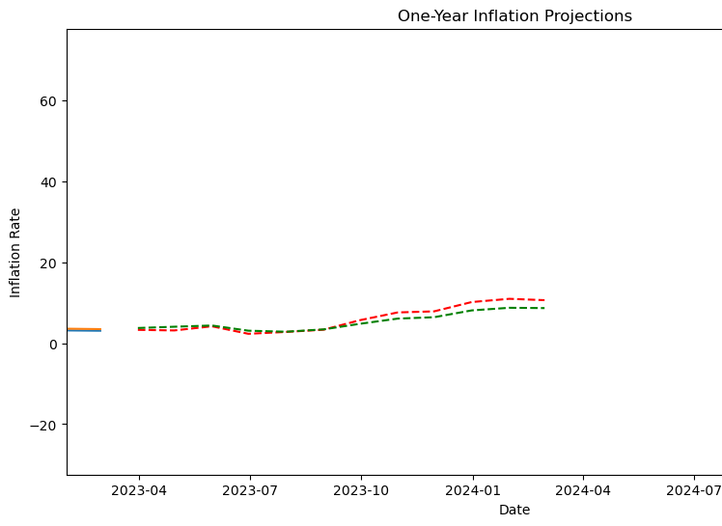
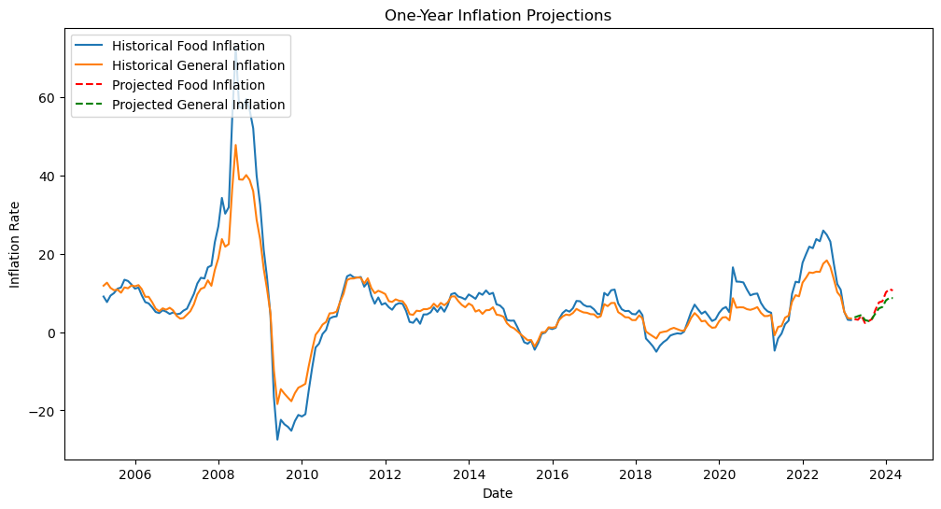
Data Analysis:
Plot Historical and Projected Inflation Values:

Slide 11
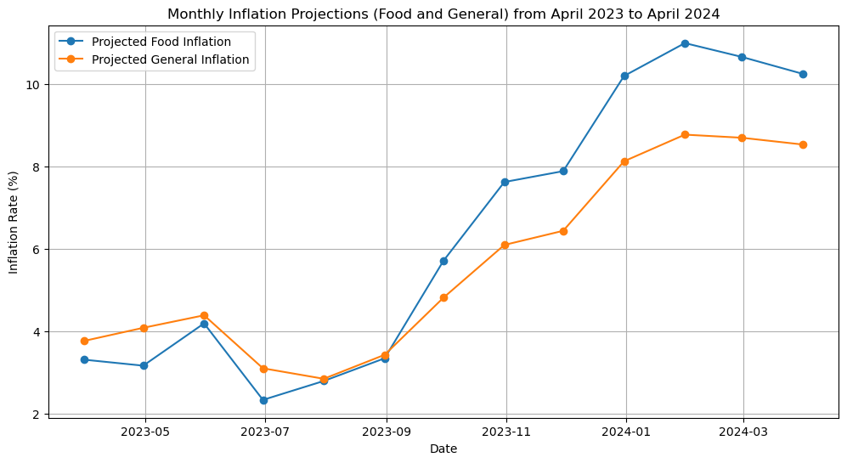
Data Analysis:
Line plot for both Food Inflation and General Inflation projections:

Slide 12
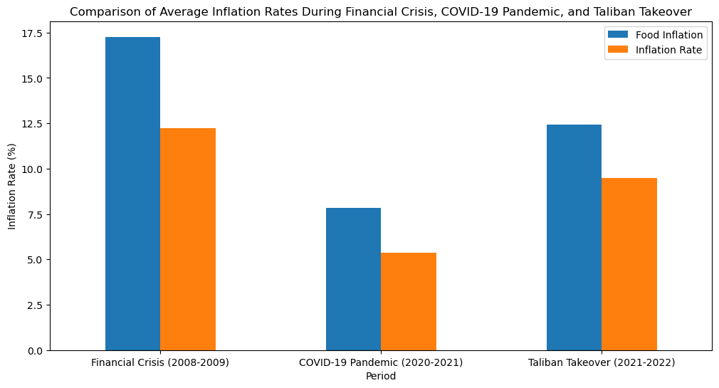
Data Analysis:
Bar Plot Comparing Food Inflation to Inflation Rate:

Slide 13
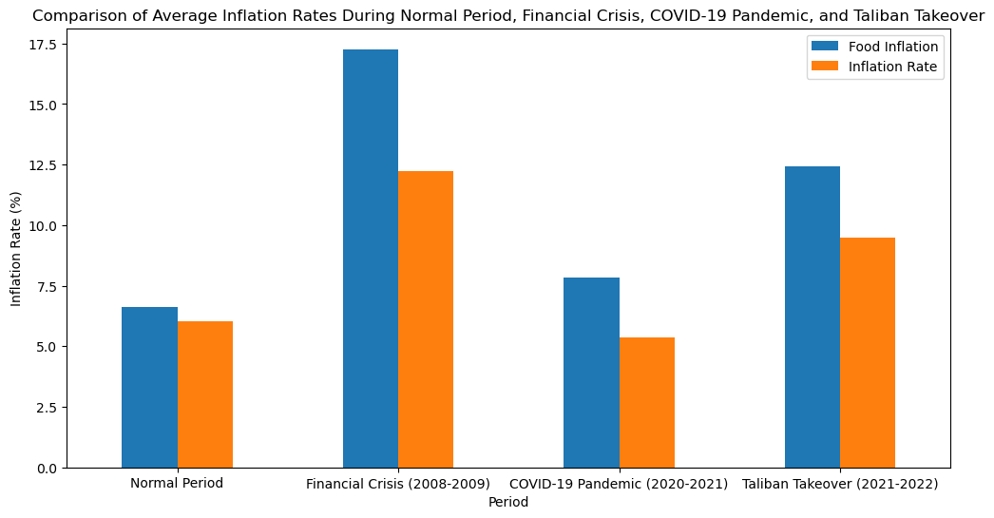
Data Analysis:
Bar Plot Comparing Food Inflation to Inflation Rate and Normal Period:

Slide 14
Conclusions:
Research Question:
How have global economic events, such as the 2008 financial crisis, the COVID-19 pandemic, and Taliban Takeover affected food price inflation?
Looking at the bar plots we can see that the data analysis indicates that the unpredicted events 2008 financial crisis, the COVID-19 pandemic, and the Taliban Takeover did have an affect on the inflation rates in Afghanistan.
The Financial Crisis had the greatest effect on Food Inflation as well as the Inflation Rate. Both Food Inflation and Inflation Rate where increased during the Financial Crisis.
The Taliban takeover also influenced the Food Inflation and Inflation Rate by increasing both economic values.
The COVID-19 unlike the other two events increased the Food Inflation, but decreased the Inflation Rate overall
COVID-19 is a unique event and is unlike the other two events in that it was a pandemic

Slide 15
Conclusions:
The data analysis was evaluated over a one-year inflation projection and a two-year inflation projection.
Note: Trying to perform a projection beyond two years caused the model to fail.
For one-year inflation projection, we used time series forecasting method SARIMAX models to predict future food price inflation rates based on historical data.
Inflation rates were predicted to increase on both the one and two-year projections
However, it should be noted that the projected increase is gradual and if we focus on the one-year projection there is some indication that it may level off or even begin to decrease
Food price inflation is an important metric to inform economic policy but traditional sources of consumer prices are often produced with delay during crises and only at an aggregate level. This may poorly reflect the actual price trends in rural or poverty-stricken areas, where large populations reside in fragile situations

